Slide 1
01
DATA STRUCTURE PROJECT
Student Management System
Alif - 2702364950
Suwandi - 2702350775
Rheynorich -2702350724

Slide 2
02
Problem Description
We are developing a student management system in Java to manage students’ records , including their information, course enrollment, and balance. The program should allow the user to add,and search for students’ status, as well as manage course enrollment. The student would be able to view their balance and pay the tuition.

Slide 3
Data structures used
For this management system we are using:
HASHMAPS
&
ARRAYLIST

Slide 4
Data structures Comparison
Effectiveness
ArrayList
HashMap
Sequential access: ArrayList implementation is efficient for iterating over all students, as elements are stored one after another
Insertion Order: ArrayList preserves the order of insertion, which might be useful if the order in which students are added need to be maintaned
Direct access: The hashmap implementation gives direct access to students using their IDs
No order guaranteed: The hashmap function does not give the information in a specific order. This might be a limitation if order of the information is important

Slide 5
Data structures Comparison
Time complexities
ArrayList
HashMap
Adding: O(1) , as adding an element to the end of an ArrayList is typically constant time, but can be occasionally O(n) when resizing occurs.
Searching: O(n), as finding a student by ID requires a linear search through the list.
Enroll/ Drop course/ Pay tuition: O(n) for finding the student and O(1) for operation on the student object.
Adding: O(1) on average, since inserting into a hash map is typically constant time.
Searching: O(1) on average, as hash map lookups are constant time.
Enroll/Drop course/ Pay tuition : O(1) for both finding the student and performing operations on the student object.
Worst case: If the elements hash to the same bucket, operations may degrade to O(n) due to collision resolution

Slide 6
Data structures Comparison
Space complexities
ArrayList
HashMap
ArrayList: O(n) for storing n students. There is some additional space overhead for storing the internal array and for potential resizing operations
Memory Overhead: Arraylist can waste memory because of resizing and internal allocation. Over-allocation can cause unnecessary memory usage.
HashMap: O(n) for storing n students. There is additional overhead for the hash table structure itself and potential space for handling collisions.
Memory Overhead: HashMap has a higher tendency to overhead because it has to store hash table metadata and handle collisions

Slide 7
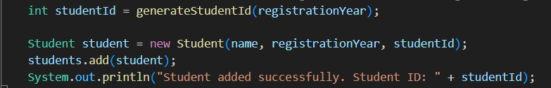
Adding & Searching Using ArrayList

Slide 8
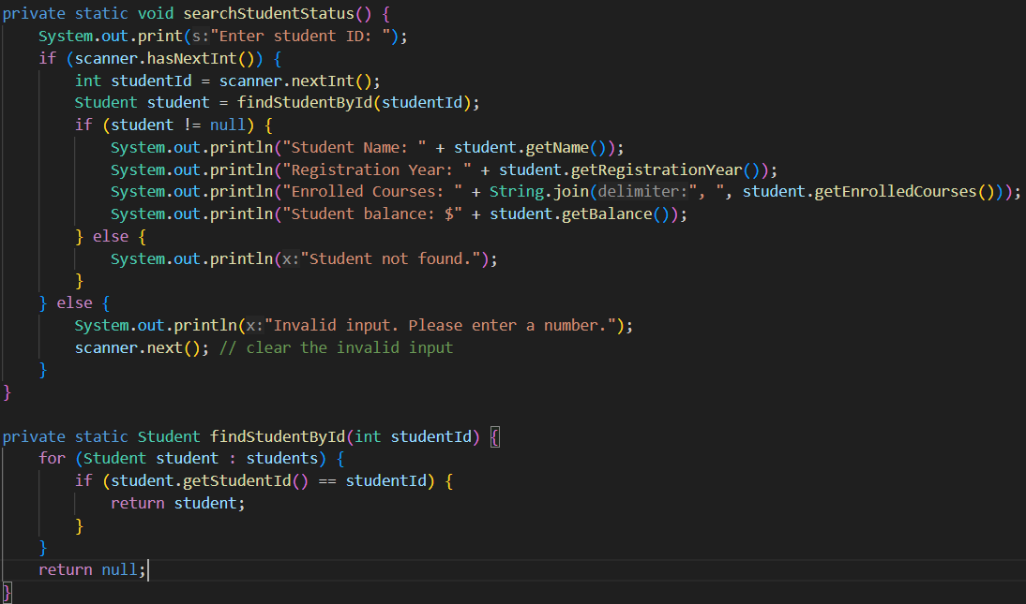
Adding & Searching Using ArrayList

Slide 9
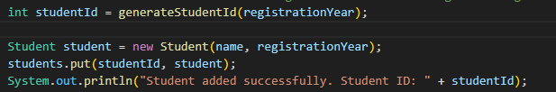
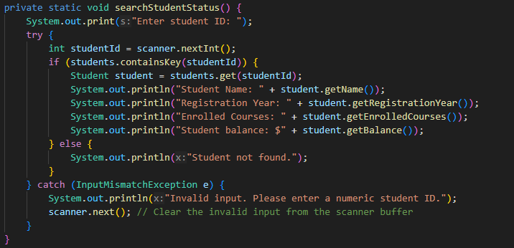
Adding & Searching using HashMap

Slide 10
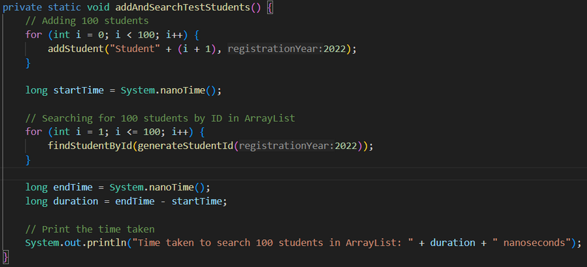
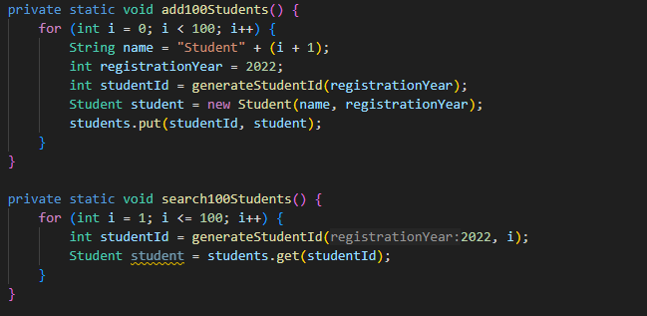
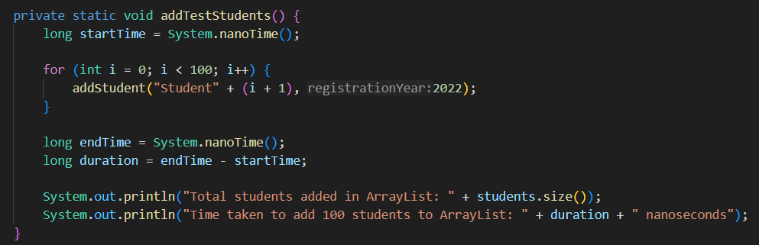
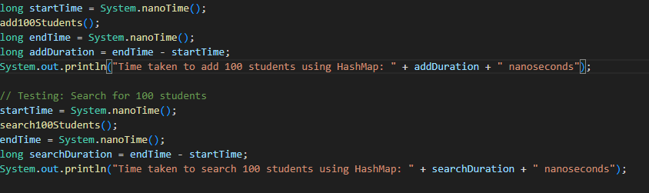
Testing
0.0108191 seconds for adding
0.0017999 for searching
0.0079241 second for adding
0.0018579 second for searching

Slide 11
Testing
0.0346316 seconds for adding
0.0085801 seconds for searching
0.0356959 seconds for adding
0.0186345 seconds for searching

Slide 12
Conclusion
The choice between ArrayList and Hashmap depends on the specific requirements of the applications. For a smaller number of elements, and preserving order matters, ArrayList is sufficient. For larger number of elements or when fast lookup times are critical, HashMap is the more effective choice. In our program that typically requires efficient lookups by student ID , and may deal with growing number of students, HashMap is the better choice since it offers constant time for most operation ( adding, searching, removing), which can be useful for managing a large dataset efficiently

Slide 13
Thank you for listening!
ALIF
SUWANDI THE
RHEYNORICH
2702364950
2702350775
2702350724

